Slide 1
Neurograph Project
Jiashu Wu

Slide 2
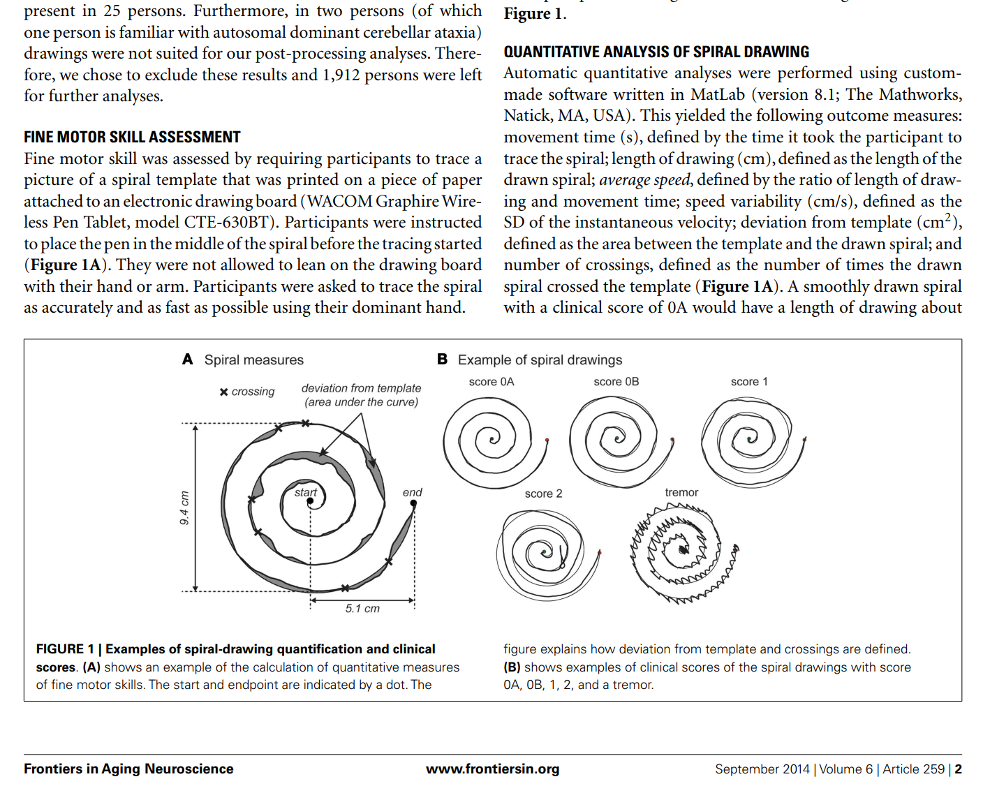
From the research papers

Slide 3
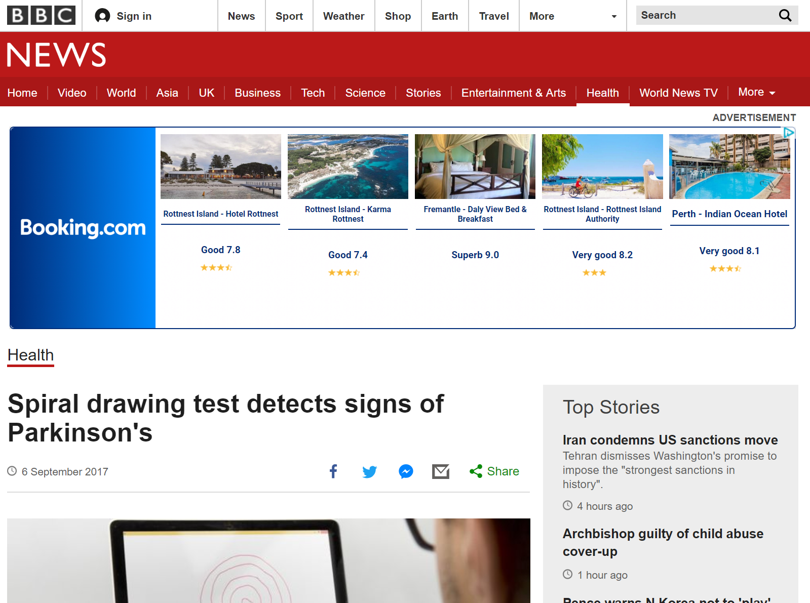
Use drawing to detect Parkinson’s Disease

Slide 4
Neurograph, Drawing patterns and Parkinson Detection
Parkinson
Shaking, maybe?
Drawing patterns may be potentially influenced
The drawing pattern may tell us something interesting

Slide 5
By studying drawing patterns, such as
Touching pressure
Drawing Speed changes
Maximum differences in horizontal direction
Total drawing time
Deviation from the template image

Slide 6
Analyse them statistically,
We could find some drawing characteristics that’s special for Parkinson patients.

Slide 7
What this project contains
Two parts
Part 1: An app which captures the drawing data
Store the data into different format of data files which can be analysed
Part 2: Analyse the drawing data and study interesting features (Done by Cathy)

Slide 8
Procedure of the app
A new user
Register
Do the tests
He/she can come back using the registration code (Something like an user name, it’s unique)
Do the tests again to see whether the disease condition changes or not

Slide 9
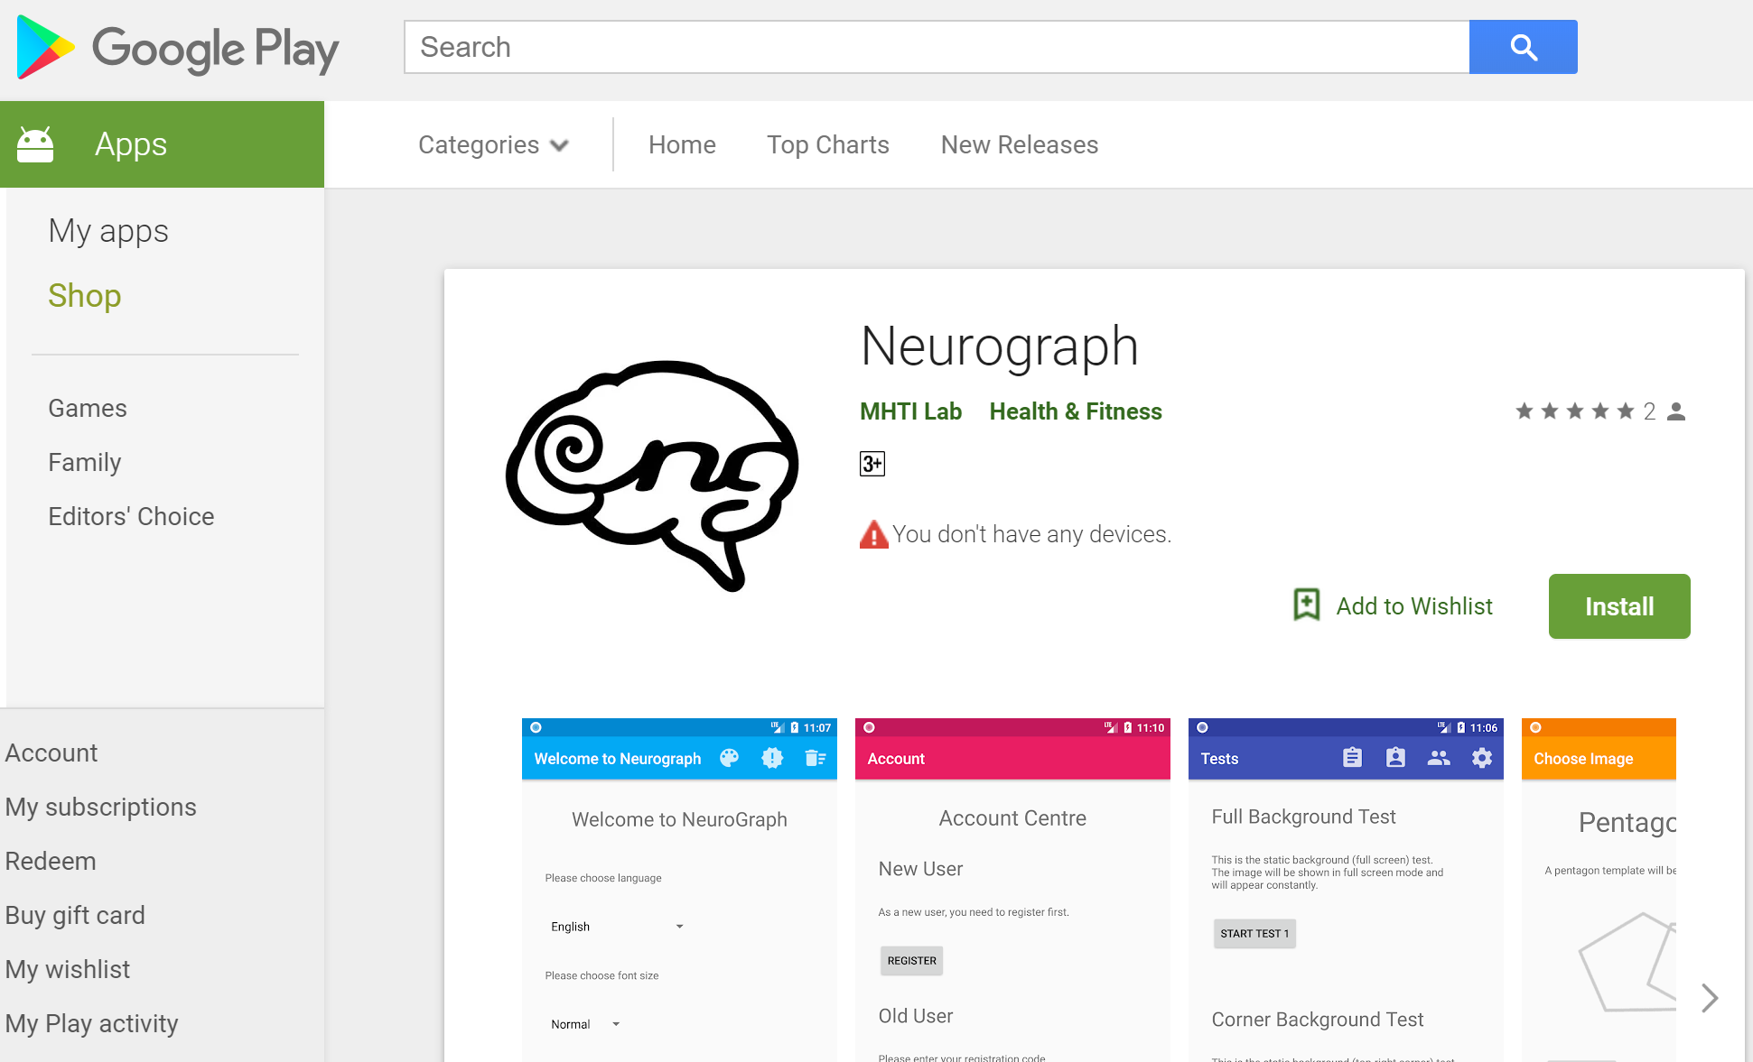
App demonstration

Slide 10
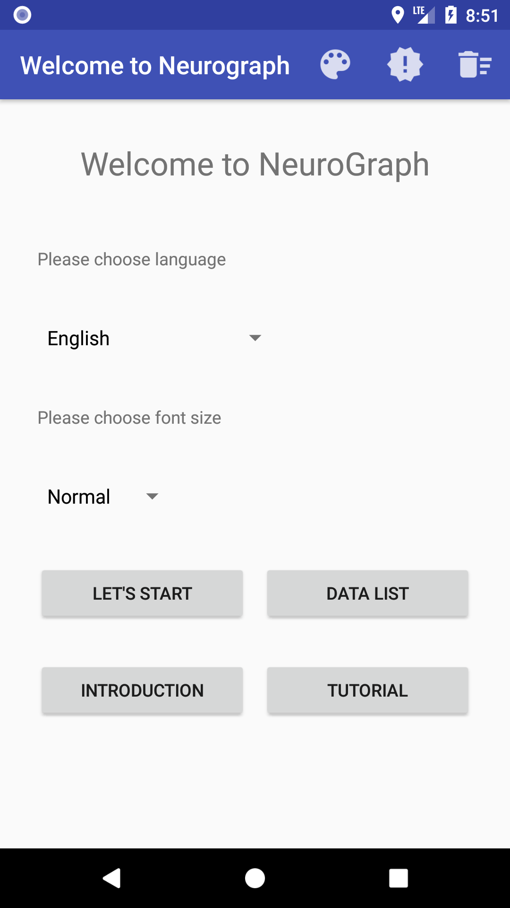
The app
Collect information about the user
The tests
Output the data

Slide 11
Future TODOs
Identify Signatures

Slide 12
Q & A

Slide 13
Thank you ^_^

